Slide 1

Pre-requirements:
Python Basics
Chrome Web Browser
Internet Connection
Download links:
PYTHON
PYCHARM
Documents:
Selenium unofficial

Slide 2
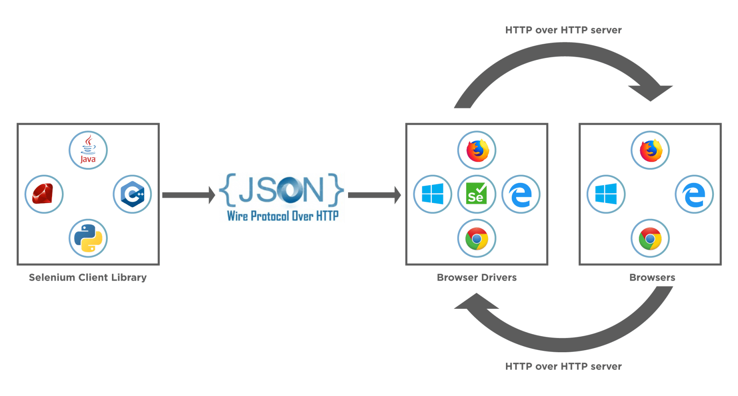
Selenium architecture

Slide 3
Navigation:
driver.get("{website_url}")
Locators (to locate the web element):
ID = "id"
XPATH = "xpath"
LINK_TEXT = "link text"
PARTIAL_LINK_TEXT = "partial link text"
NAME = "name"
TAG_NAME = "tag name"
CLASS_NAME = "class name"
CSS_SELECTOR = "css selector"
Common Actions:
.send_keys() = to enter input value in a blank
.click() = to give click command
.clear() = to clear the input field
.text = to copy the text

Slide 4
CSS Selector Locator
Note: Tagname is optional
FROM | SYNTAX
Class, Attribute & Value | tagname.classvalue[attribute = ‘value’]
Attribute & Value | tagname[attribute = ‘value’]
ID | tagname#IDvalue
Class | tagname.classvalue

Slide 5
XPATH Locator 1
FROM | SYNTAX
Attribute & Value | //tagname[@attribute = ‘value’]
2 Attributes & Values | //tagname[@attribute1 = ‘value1’ and/or @attribute2 = ‘value2’]
Text | //tagname[text() = ‘type text here’]
Starts with | //tagname[starts-with(@attribute,’starting values’)]
contains | //tagname[contains(@attribute,’value’)]
Starts with and contains | //tagname[starts-with(@attribute1,'starting values') and/or contains(@attribute2,’value')]
Partial Text | //tagname[contains/starts-with(text(), ‘partial text here’)]
Use * if don't want to use specific tagname or attribute.

Slide 6
XPATH Locator 2
FROM | SYNTAX
Parents to any child or grandchild | //tagname[@attribute = ‘value’]//tagname[@attribute = ‘value’]
Parents to specific no. of child or grandchild | (//tagname[@attribute = ‘value’]//tagname)[number]
Parents to last child or grandchild | (//tagname[@attribute = ‘value’]//tagname)[last()]
Parents to 3rd last child or grandchild | (//tagname[@attribute = ‘value’]//tagname)[last()-2]
Child to any ancestor | //tagname[@attribute = ‘value’]/ancestor::tagname[@attribute = ‘value’]
Parent to first n number of child | (//tagname[@attribute = ‘value’]//tagname)[position() >,<,= number]
/ means absolute, // means relative.

Slide 7
PYTHON SELENIUM with PYTEST
( HINDI 2023 )
#13 - EXPLICIT WAIT

